Slide 1

MyTaxiService Design Document Software Engineering 2, 2015/2016
Nenad Petrović

Slide 2
High level architecture and component interaction

Slide 3
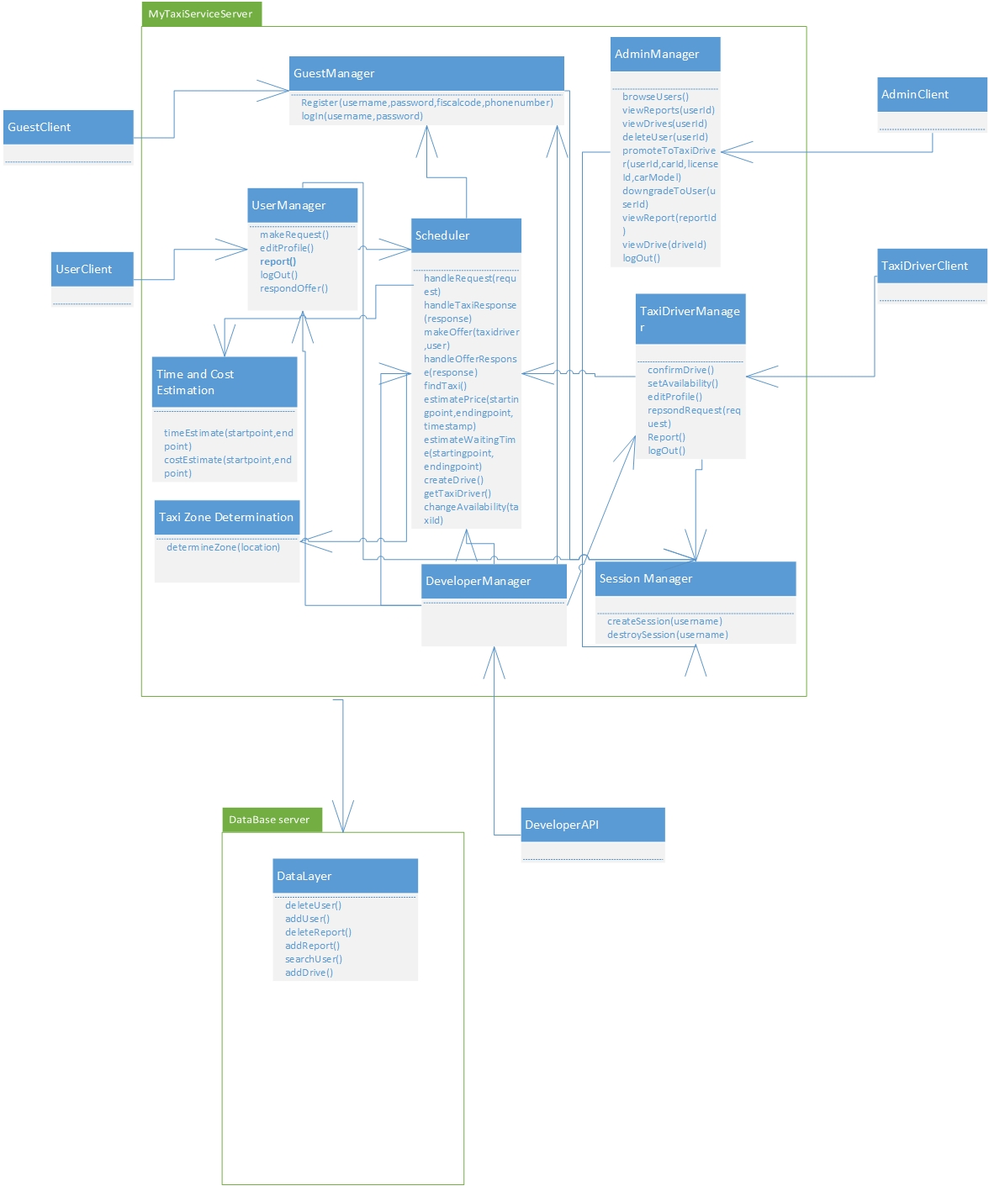

Slide 4
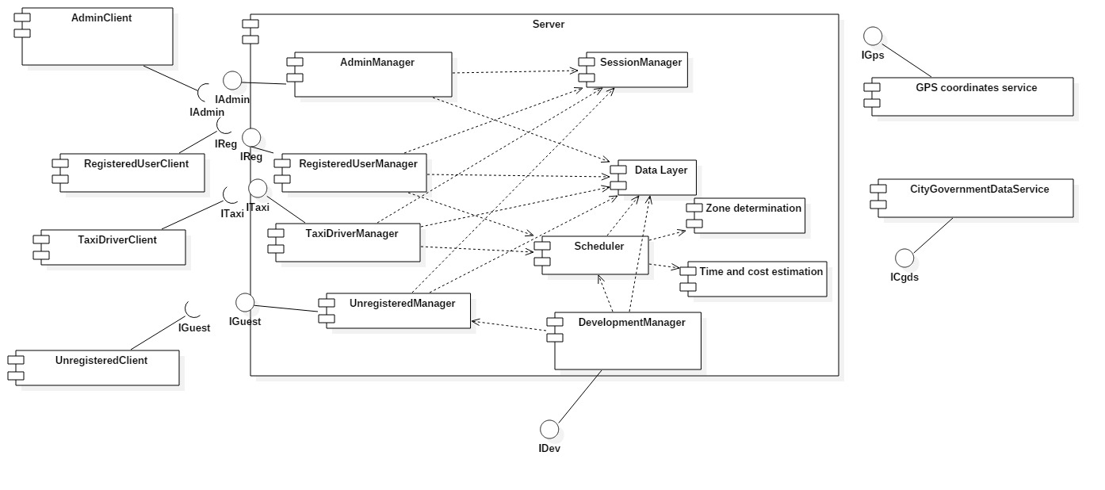
Component view

Slide 5
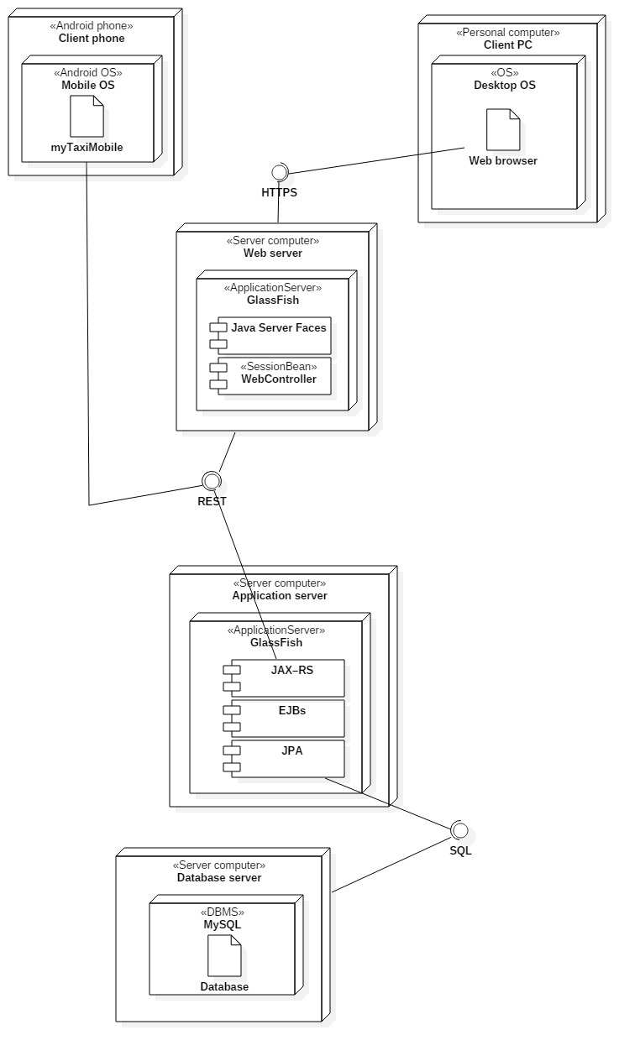
Deployment view

Slide 6
Runtime view

Slide 7
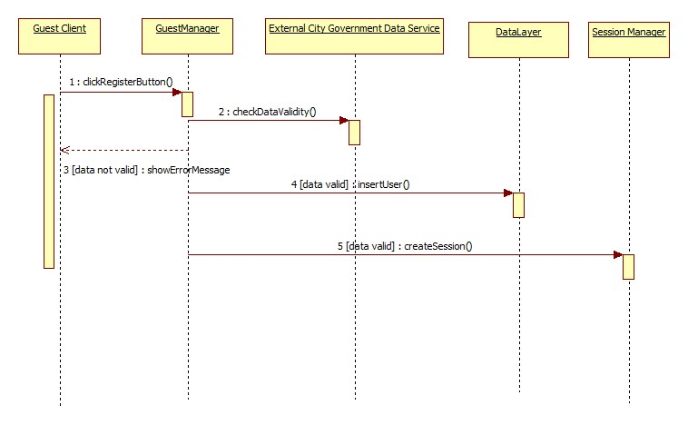
Register user

Slide 8
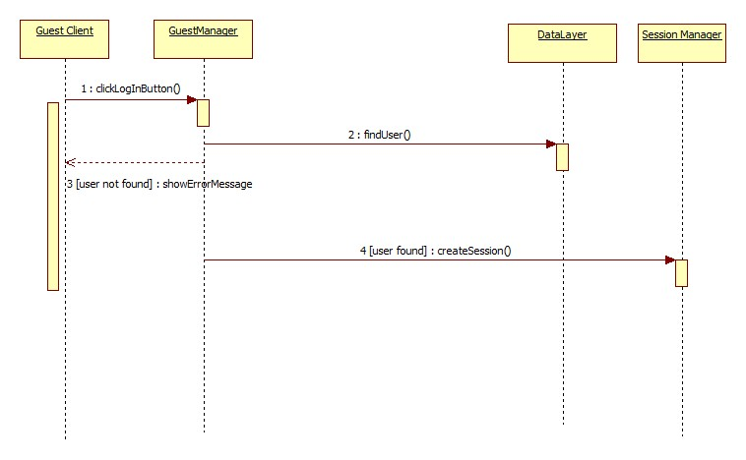
Log in

Slide 9
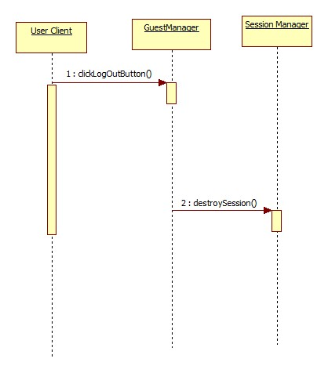
Log out

Slide 10
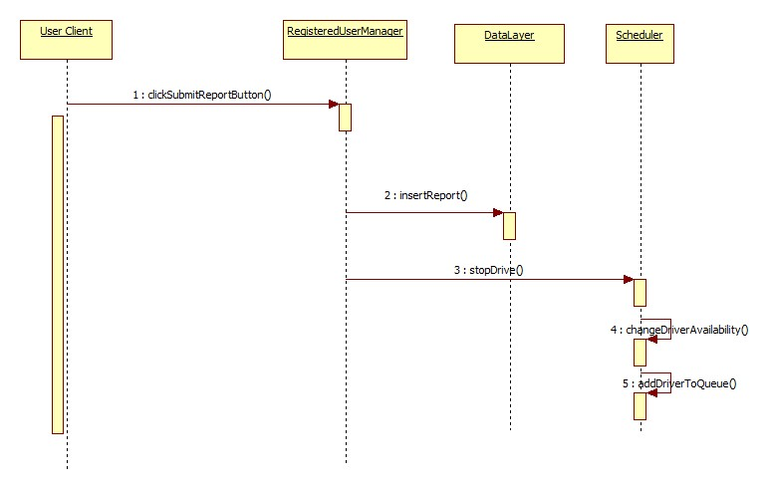
Report user

Slide 11
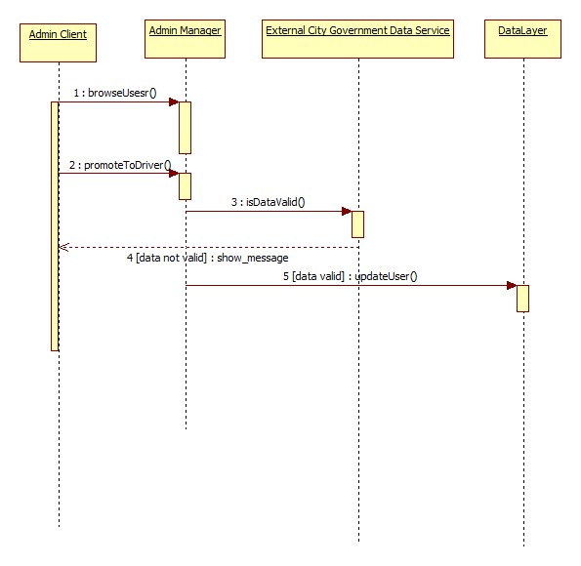
Promote to taxi driver

Slide 12
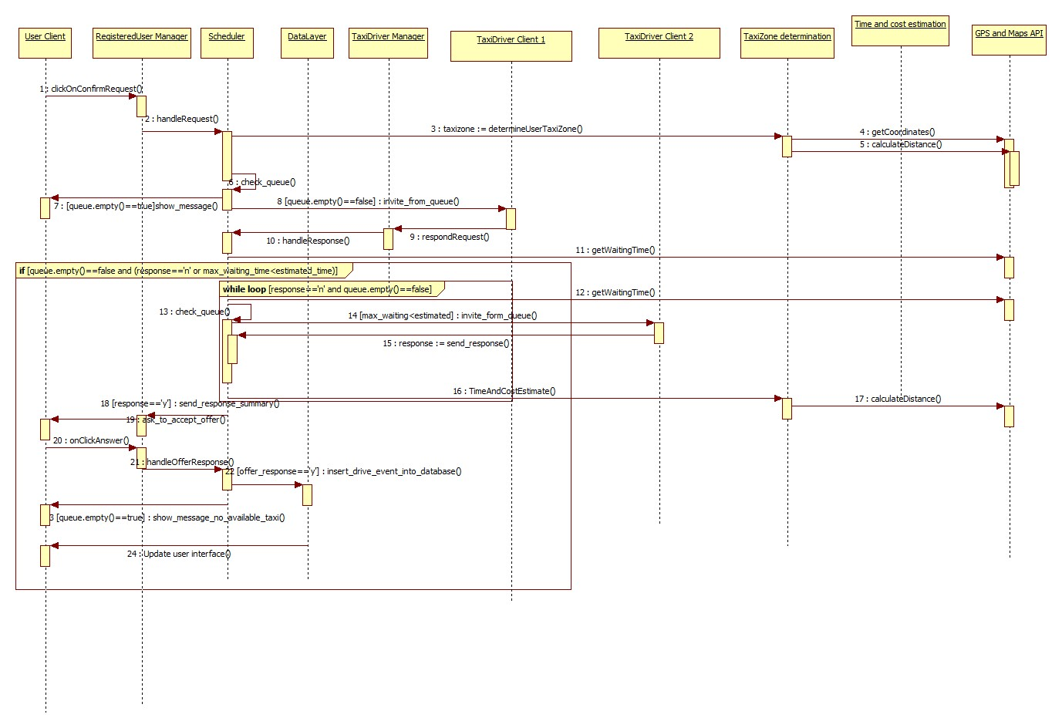
Request taxi

Slide 13
Component interfaces

Slide 14
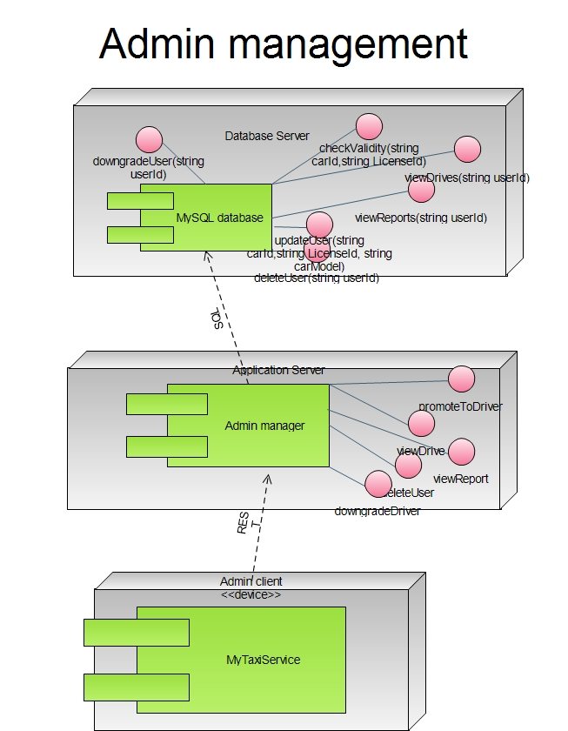

Slide 15
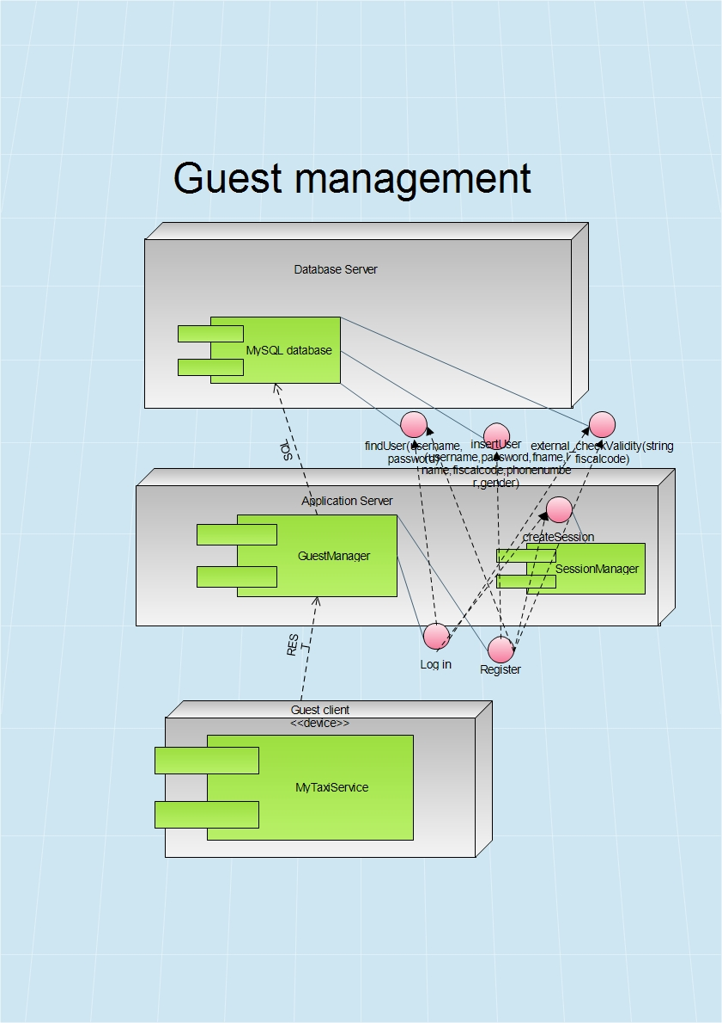

Slide 16
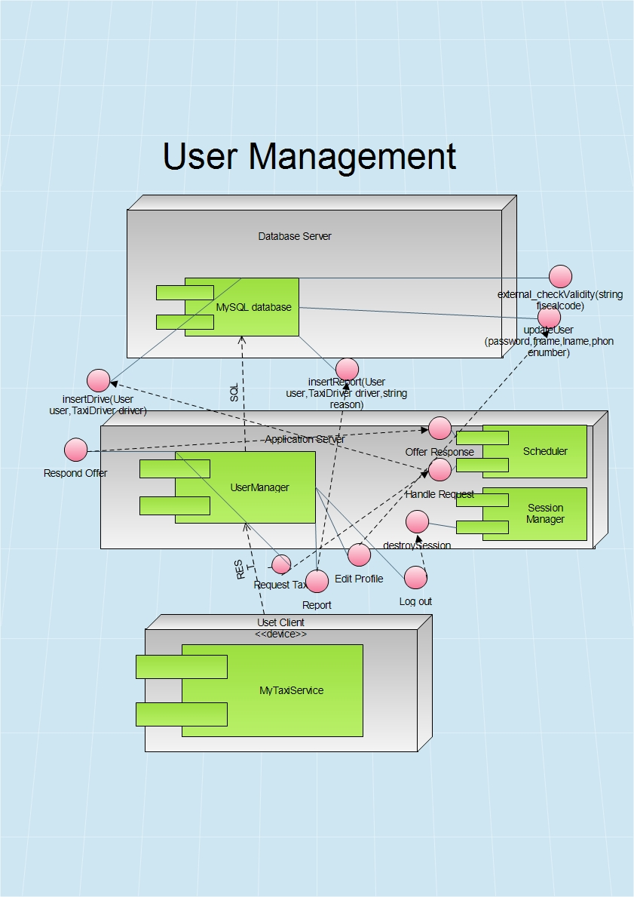

Slide 17
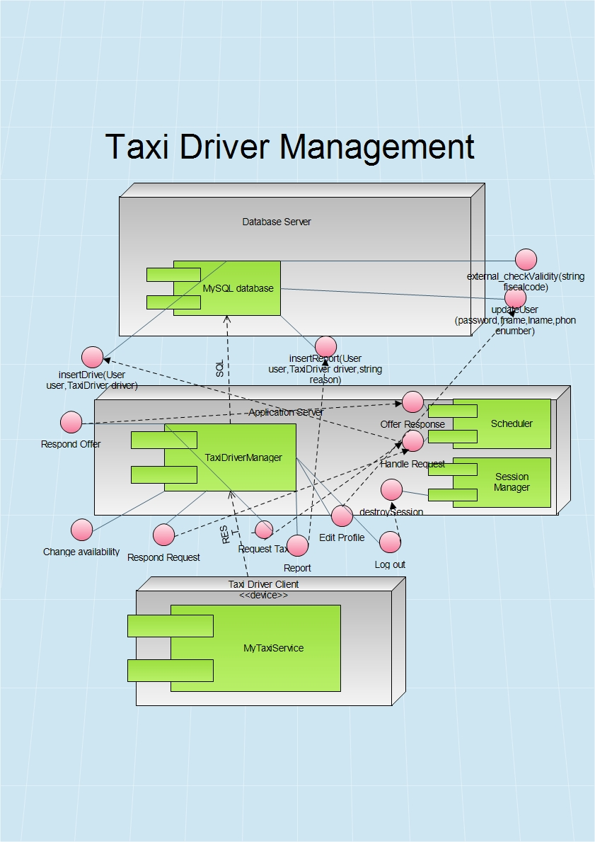

Slide 18
Algorithms
Queue dispatching/scheduling
Cost estimation
Taxi zone determination

Slide 19
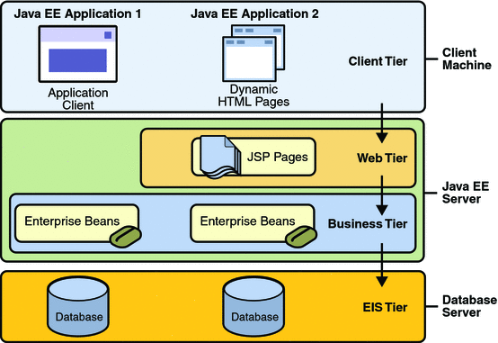
Java EE multitier

Slide 20
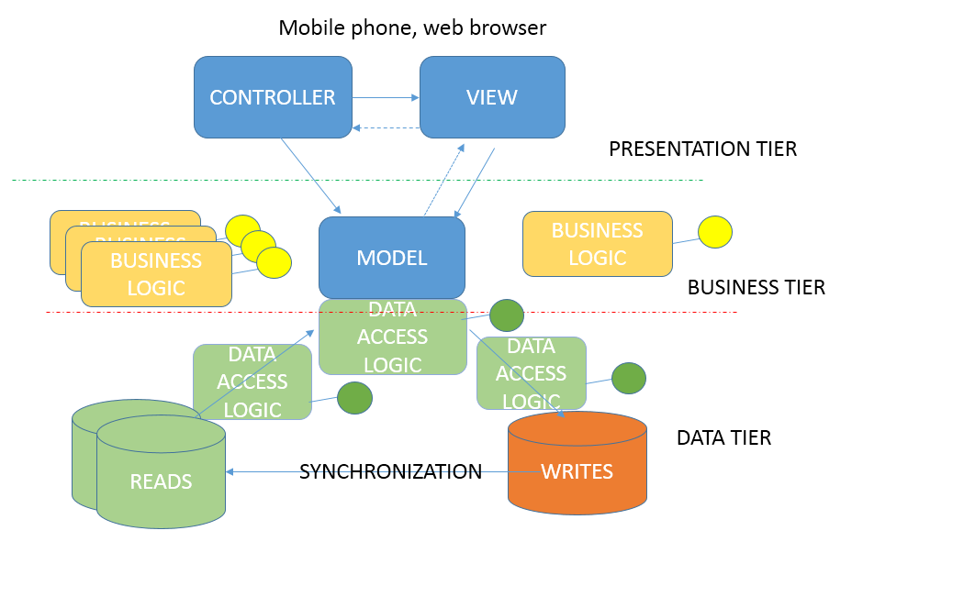
MVC variant

Slide 21
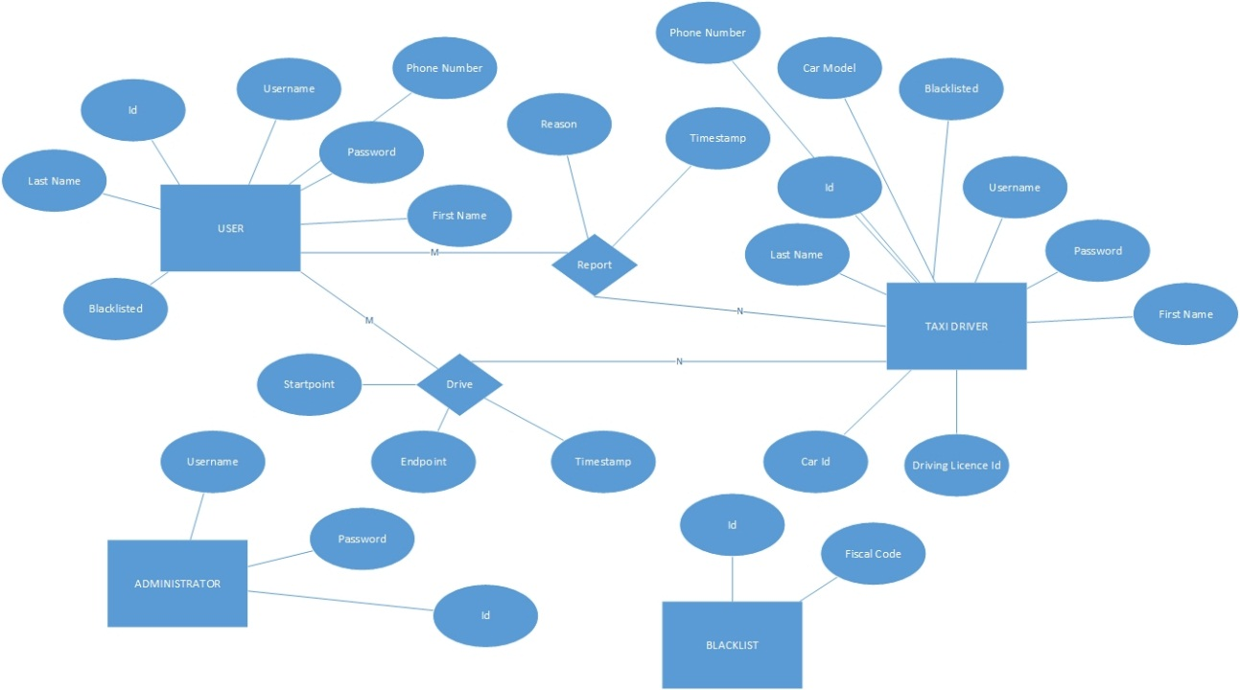
Database

Slide 22
Requirements traceability
Registration/Taxi driver promotion data check – External database
GPS coordinates determination and calculation – External GPS/Maps API
Blacklist – db storage
Reports – db storage
Maintainability – flexible cost estimation algorithm
API for developers

